Slide 1

St. Xavier’s College of Management & Technology
NAAC Accredited with B++ Grade(First Cycle)
Digha Ghat, Patna - 800011
St. Xavier’s College of Management & Technology
NAAC Accredited with B++ Grade(First Cycle)
Digha Ghat, Patna - 800011
Project Review 1
AI Transcript Generator
Project being developed under the Guidance of Prof.
Dr. Supriya Shree
Team Member – Sumit Kumar (Roll No: 17)
Princy Raj (Roll No: 11)
Department – Computer Science
1
1

Slide 2

Contents
Introduction
Problem Statement
Objective
Technology Used
Key Features
Module Explanation
Workflow
Installation & Setup
Project Sample
Conclusion

Slide 3

AI Transcript Generator
A modern AI-powered tool for YouTube video summarization. This tool enhances accessibility and efficiency.
How it works :-
Transcription
Text Processing
Summarization
Output Display

Slide 4




Project Overview
The YouTube AI Summarizer project aims to provide
quick insights.
It enhances accessibility and efficiency through AI-driven video summarization. It benefits users needing fast summaries.
Overview
Importance
Efficiency
Details of the YouTube AI Summarizer project.
Highlights AI-driven video summarization importance.
Enhances accessibility and efficiency for users.

Slide 5

The Problem statement
YouTube videos contain vast information but are
time-consuming.
Users require quick insights without watching the full video. Manual summarization is inefficient.
1
Time Consuming
2
Need for Speed
Videos are long, requiring significant viewing time.
Users seek quick insights and summaries.
3
Manual Effort
Manual summarization is tedious and impractical.

Slide 6

Project Objectives
Concise Summaries
Generate accurate, brief video summaries.
Multilingual
Offer summaries in English and Other.
Multiple Styles
Provide video and podcast-style summaries.
User-Friendly
Ensure a seamless, modern UI experience.

Slide 7





Key Features
Offers multiple AI models and flexible API key usage.
Supports multilingual summaries and includes a smart history system.
Flexible API Keys
2
Multiple AI Models
1
Multilingual Support
3
5
Smart History
4
Summary Modes

Slide 8
Tech Stack
The project uses Next.js, Node.js, and SQLite.
AI models include - Google Gemini 2.0,
Groq Llama 70B ,
GPT-4o-mini, ensuring robust performance.
Frontend
Backend
Database
AI Models
Next.js (React Framework), Tailwind CSS
Node.js, Express.js
SQLite (stores summary history)
Google Gemini 2.0,
Groq Llama 70B,
GPT-4o-mini

Slide 9





System Modules
The system consists of five core modules.
These modules include video extraction, audio processing and speech-to-text conversion.
Video Extraction
Retrieves video metadata.
Text Post-Processing
Cleans and structures text.
Audio Processing
Converts video to audio.
Output Options
Generates summaries.
Speech-to-Text
AI-powered transcription.

Slide 10
Workflow
Input URL
1
Enter YouTube URL.
2
Select Options
Choose language and type.
Select AI Model
3
Choose an AI model.
4
Generate Summary
Click "Generate Summary."
View Output
5
See progress & summary.

Slide 11
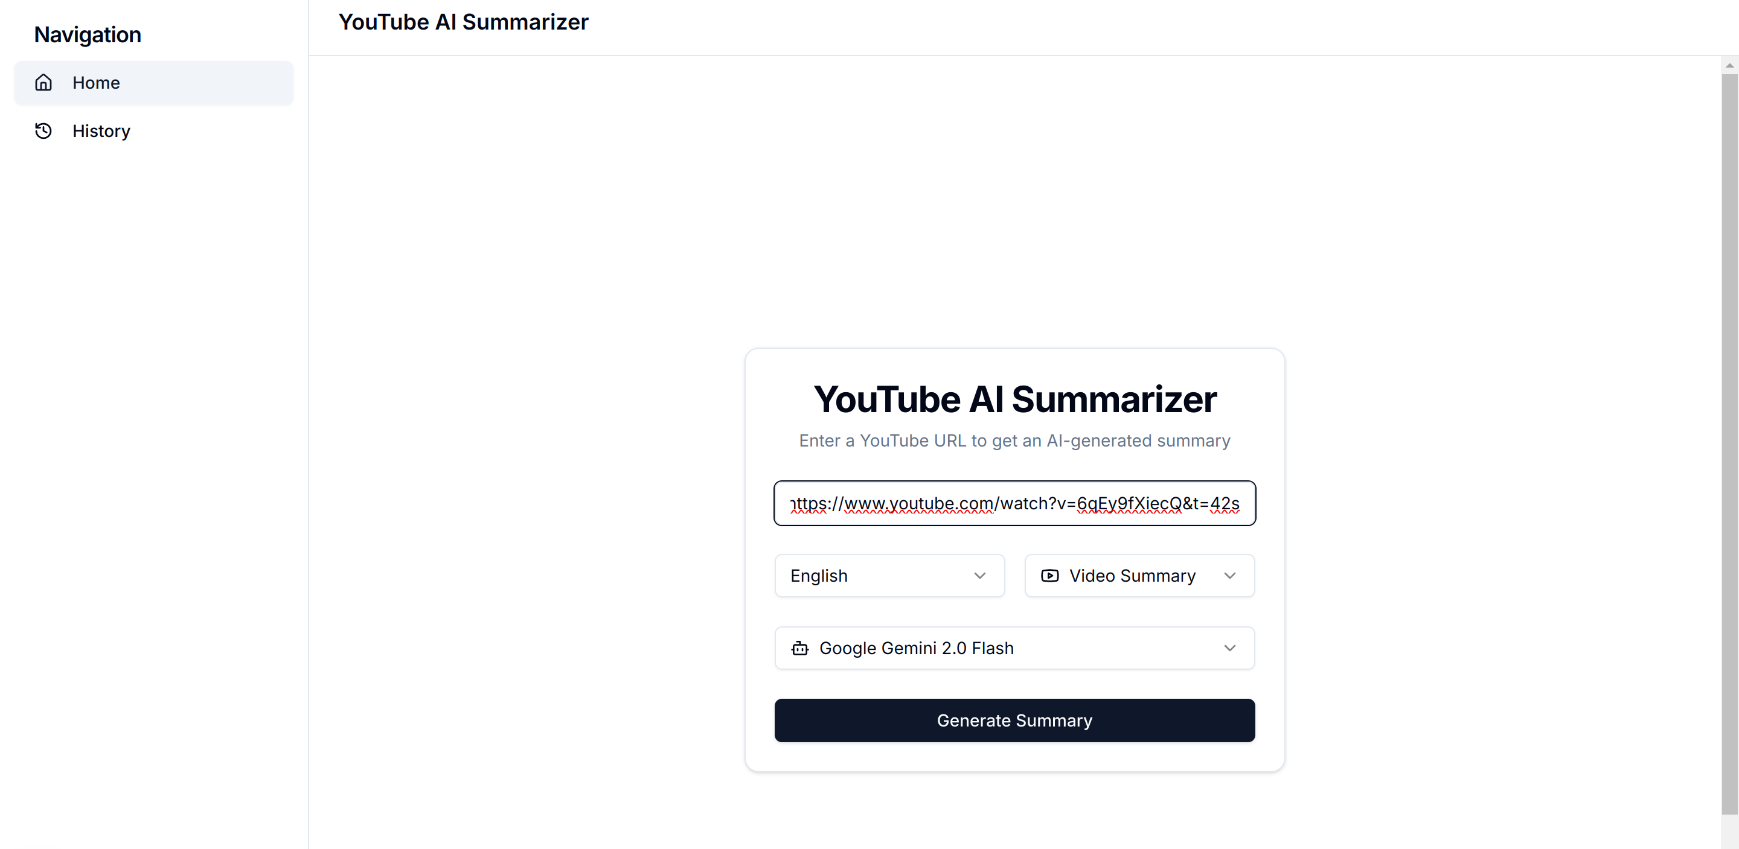
Project Sample
01

Slide 12
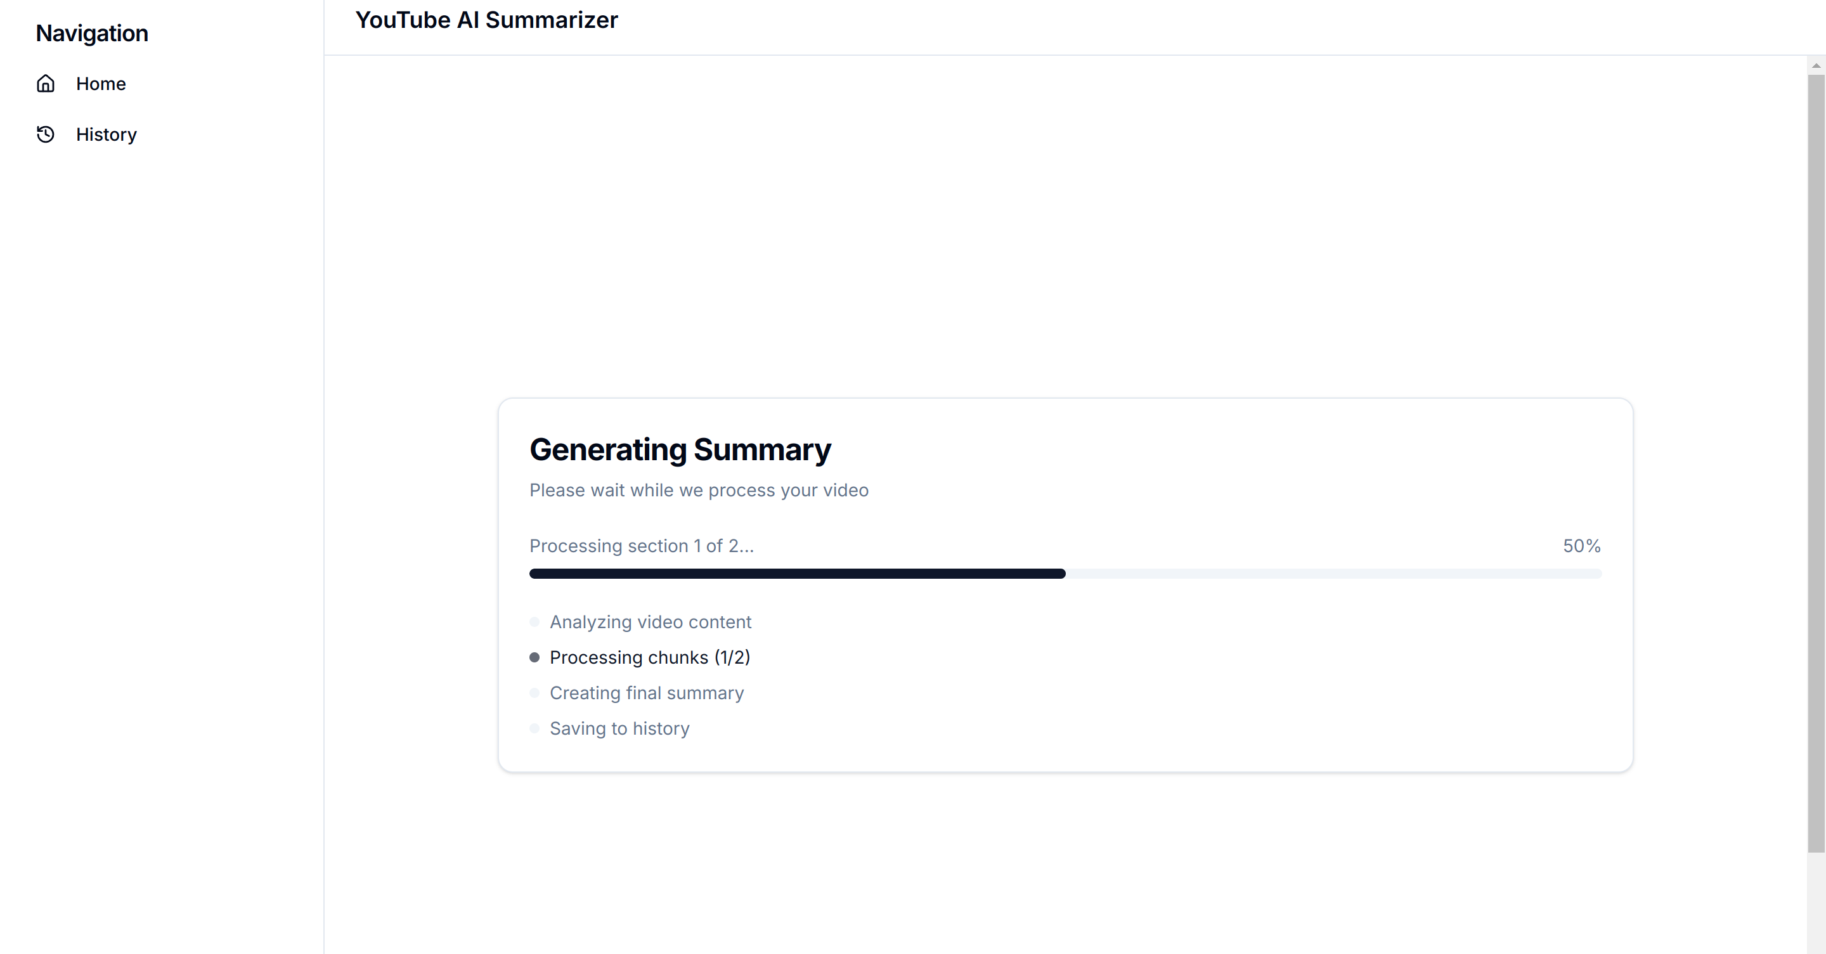
Project Sample

Slide 13
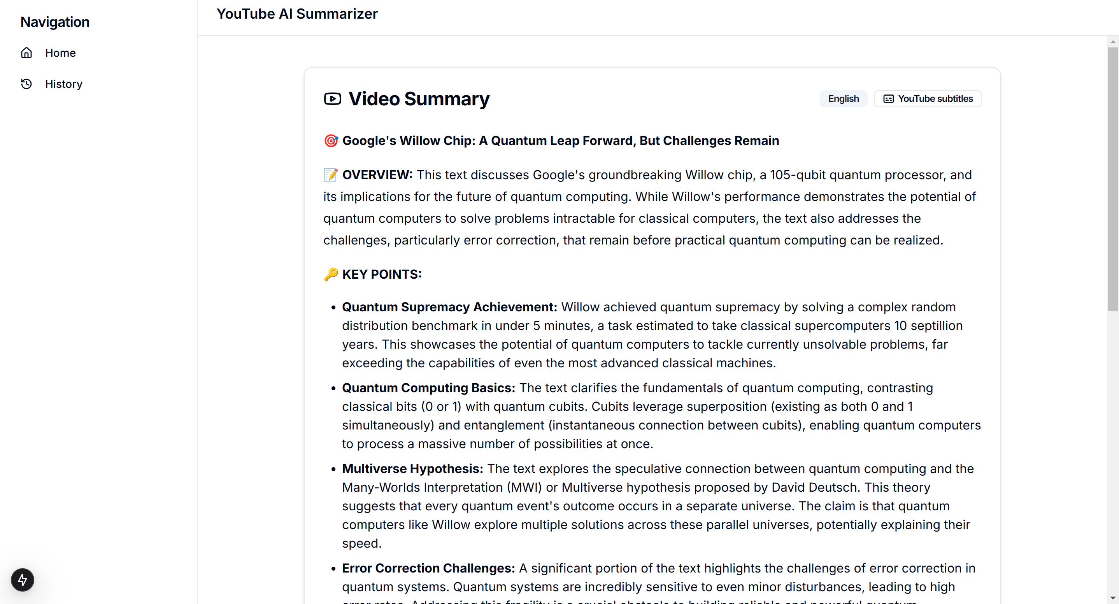
Project Sample

Slide 14
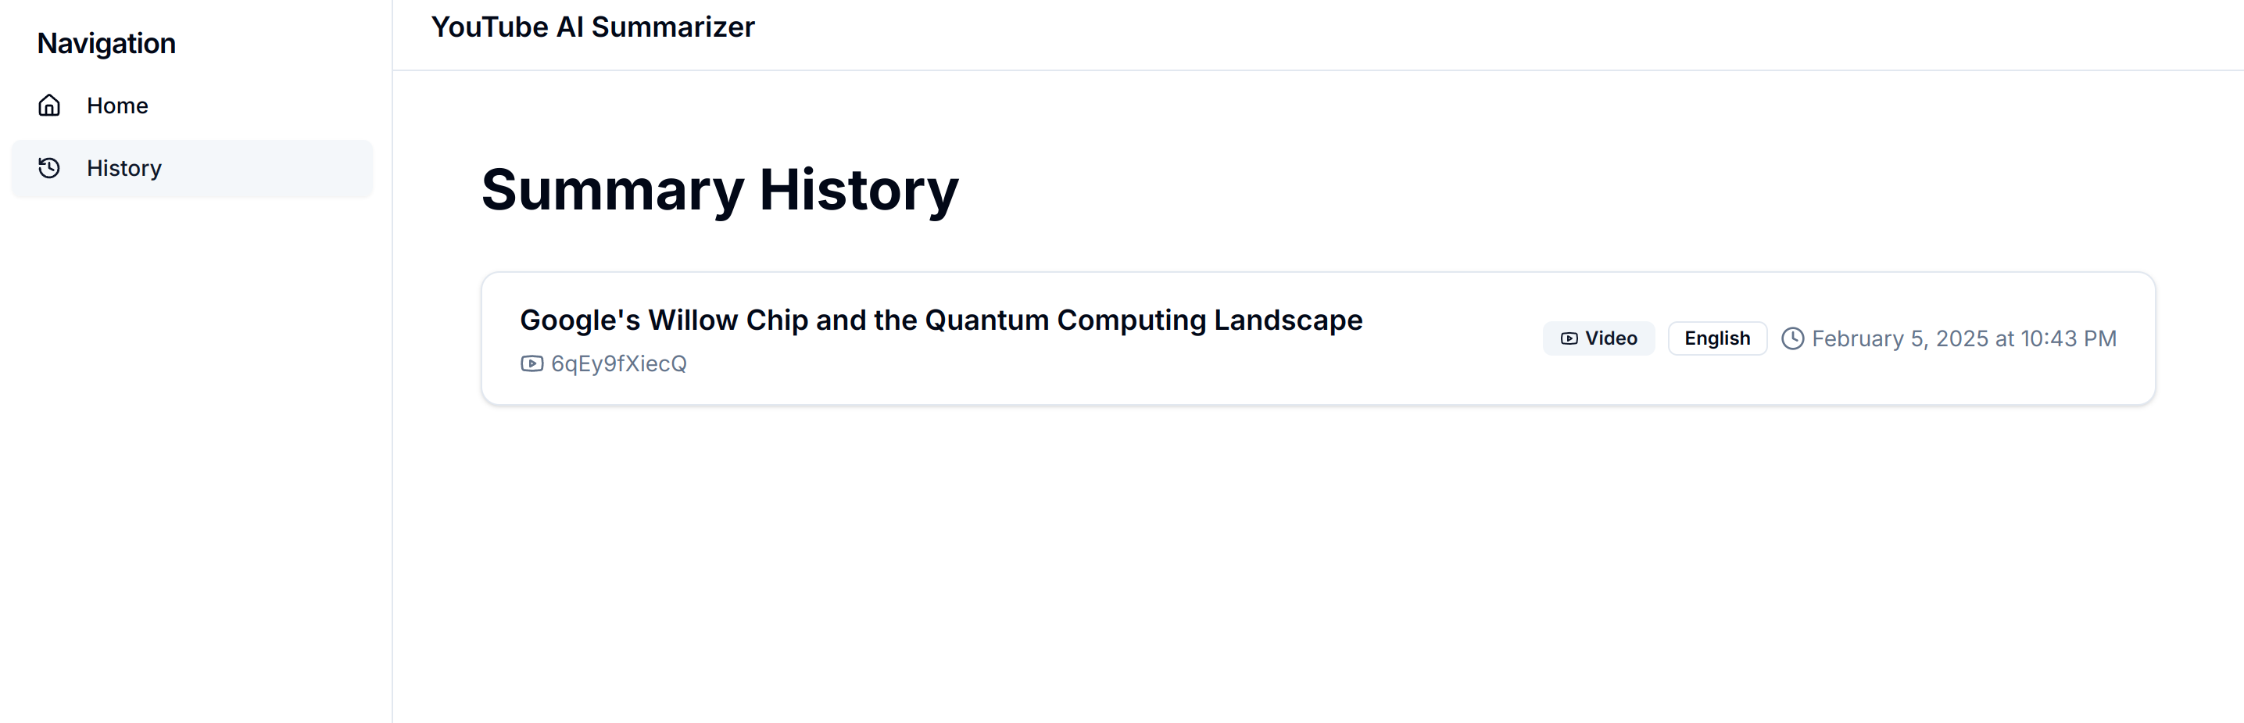
Project Sample

Slide 15
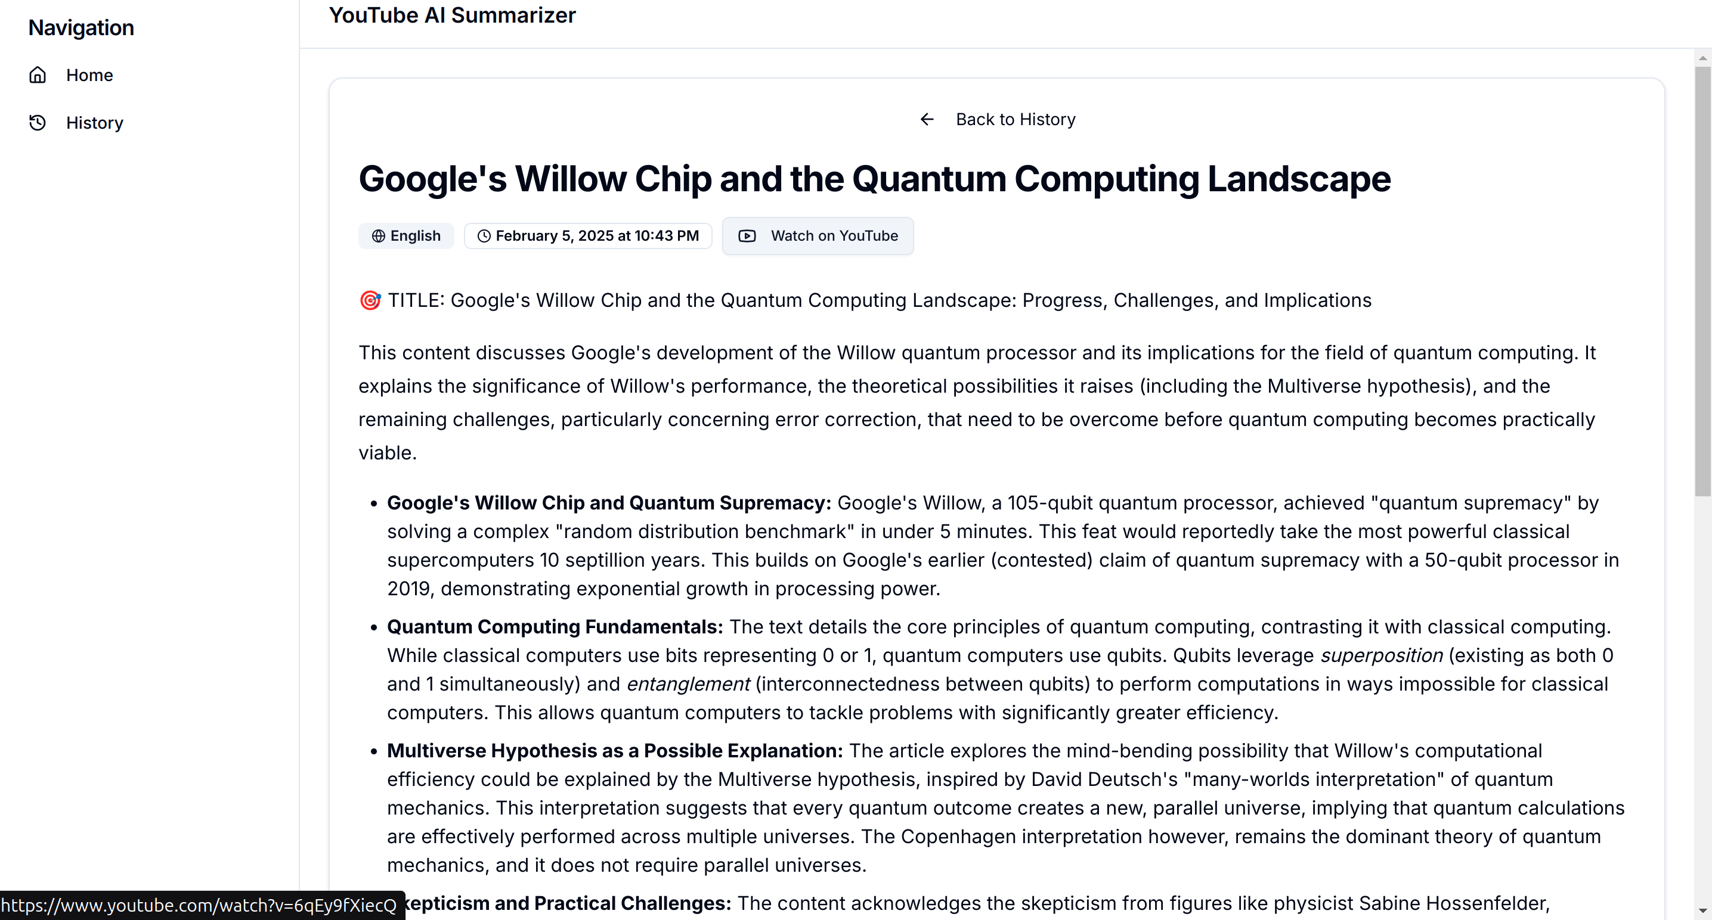
Project Sample

Slide 16
Installation & Setup
Installation is available locally or via Docker deployment.
Docker provides an easy, containerized setup. It simplifies the process.
1
Install Deps
2
Configure API
3
Setup DB
4
Run Server

Slide 17

Conclusion
The YouTube AI Summarizer delivers fast, AI-driven
video summarization.
It offers multilingual support, flexible AI models,
and a modern UI, providing a seamless user experience.

Slide 18


